Slide 1
Week 4 Q&A
簡廷因 Ting-Ying Chien
2015.10.12

Slide 2
FYI
期初問卷
10/12 ~ 10/23
新版個人portal→新課程問卷→我的學習問卷
優先選選修課

Slide 3
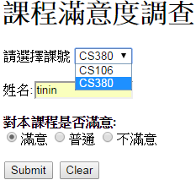

Q1: PHP example
Form.html
test.php
<!DOCTYPE html>
<html>
<head>
<meta charset = "utf-8">
<title>Forms</title>
</head>
<body>
<h1>課程滿意度調查</h1>
<form method = "post" action = "test.php">
<p>
<label>請選擇課號
<select name = "class">
<option selected>CS106</option>
<option>CS380</option>
</select>
</label>
</p>
<p><label>姓名:<input name = "name" type = "text" size = "12"></label></p>
<p>
<strong>對本課程是否滿意:</strong><br>
<label><input name = "rating" type = "radio" value = "good" checked>
滿意</label>
<label><input name = "rating" type = "radio" value = "normal">普通</label>
<label><input name = "rating" type = "radio" value = "bad">不滿意</label>
</p>
<p>
<input type = "submit" value = "Submit">
<input type = "reset" value = "Clear">
</p>
</form></body></html>
<?php
$class = $_POST['class'];
$name = $_POST['name'];
$rate = $_POST['rating'];
print ("<p>你選的課號為: $class</p>");
print ("<p>你的姓名為 : $name</p>");
print ("<p>滿意度 : $rate</p>");
?>

Slide 4
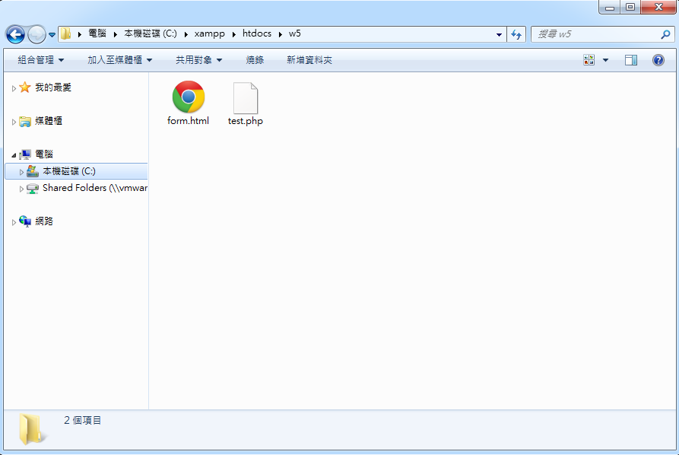
Q1: PHP example

Slide 5
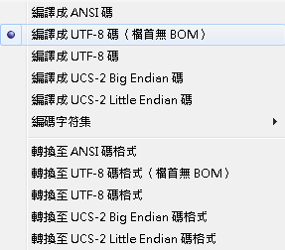
Q2 : 編碼 (windows)
Notepad++
編碼->編譯成UTF-8碼(檔首無BOM)

Slide 6
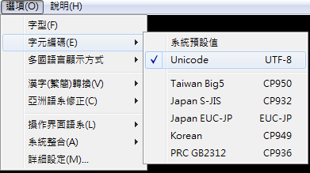
Q2 : 編碼 (linux)
Pietty
選項->字元編碼->Unicode
Big5 to Unicode
iconv -f big5 -t utf-8 big5 infile.html -o outfile.html

Slide 7
Q3 : Regular Expression
. # Matches any single character.
[ ] # Matches a single character that is contained within the brackets.
( )# Groups expressions to assist in alternation and back referencing.
^ # Matches the starting position within the string.
$ # Matches the ending position of the string or the position just before a string-ending newline.
| # or
Example:
(19|20)[0-9]{2} # 1900~2099
(mail|saturn).yzu.edu.tw # mail.yzu.edu.tw or saturn.yzu.edu.tw

Slide 8
Q3 : Regular Expression
Exercise
市話
(##) ###-####
(##) ####-####
(###) ###-###
Ans:
\([0-9]{2}(\) [0-9]{3}\-\d|\) [0-9]{4}\-\d|\d\) [0-9]{3}\-)\d{3}

